Slide 1


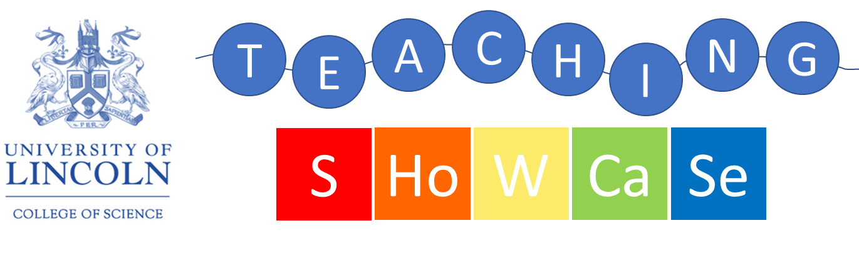
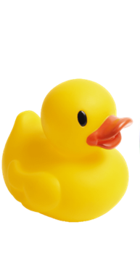
Using Github for non-programming projects
College of Science, University of Lincoln Tuesday 13th September 2022
Presenter: Mark Doughty
mdoughty@lincoln.ac.uk
Tweet about the event: @UoLScience #UoLScienceTeach

Slide 2
What is Github?
Github is an online repository service
It is free to use!
Keeps track of revisions, comments on documents (and who made them)
Open source
More widely applicable than:
OneDrive
Dropbox, etc

Slide 3
Who can use Github?
Widely used by development organisations
But loads of others as well
Seen as a vital employment skill by many
Across many sectors
Collaboration and teamworking is at its core

Slide 4
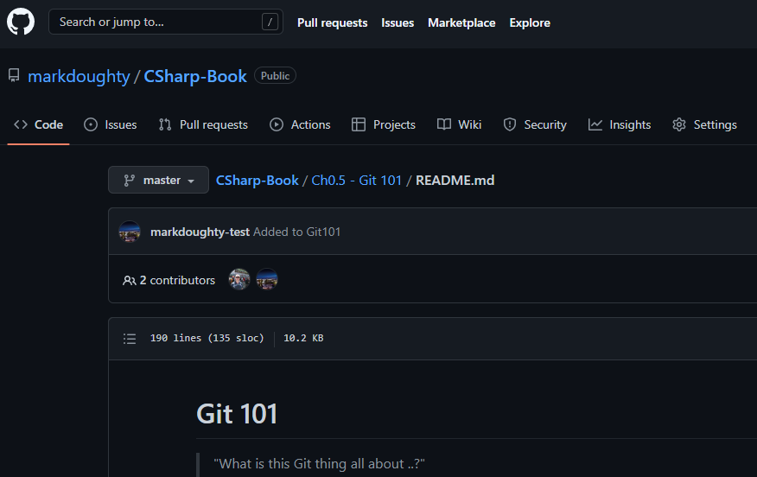
How do we use Github?
github.com
Create an account
Projects are stored in repositories, or ‘repos’
Create a repo
Allow team members (or class) to contribute to the repo

Slide 5
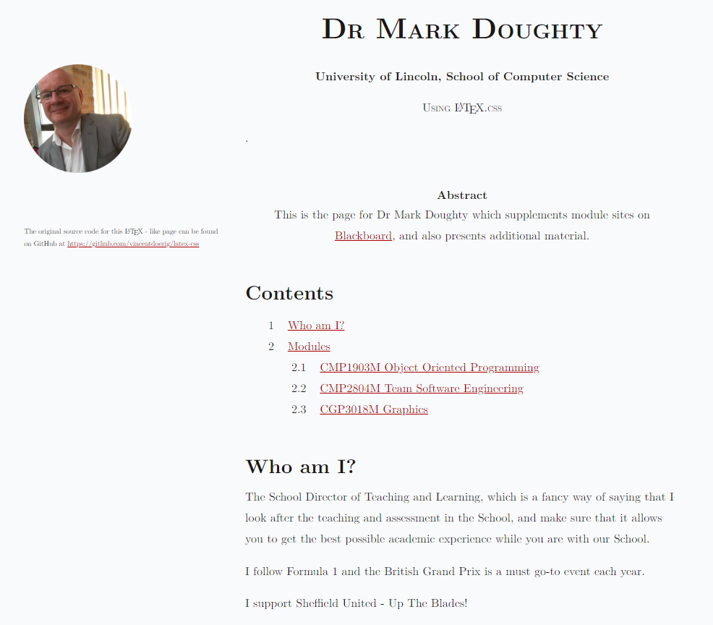
Web pages?
A repo in your account called:
<your account name>.github.io
Eg:
For me: markdoughty.github.io

Slide 6

Takeaway …
Github is useful in many workspaces
Allowing students to demonstrate basic use of Github is a good skill to add to their CV
Github.io is a useful web source
Useful for portfolios etc

Slide 7
Time for questions and discussion
Question 1:
Question 2:

